Slide 1
Chapter 12: Getting started on my first client prototype
Learning Bluemix & Cognitive
Bob Dill, IBM Distinguished Engineer, CTO Global Technical Sales

Slide 2
Getting Started:
Essential Questions
Develop and understanding of the problem space
From Understanding to Ideation
Hills and Agile: First Steps
Principles, Code and Reuse

Slide 3
Essential Questions
Who is your business sponsor?
What core issues are they facing?
What are the symptoms they face on a daily or regular basis?
How might your business sponsor state the problem?
In items 2 & 3, we’re trying to understand the difference between symptoms and root causes. Symptoms are what we see and frequently react to, Root Causes are the critical issue and what we must address in our solution.
In item 4 we’re setting up for IBM Design Thinking. One of the critical actions at the front end of an IBM Design Thinking event is clarity on the problem to be addressed.

Slide 4
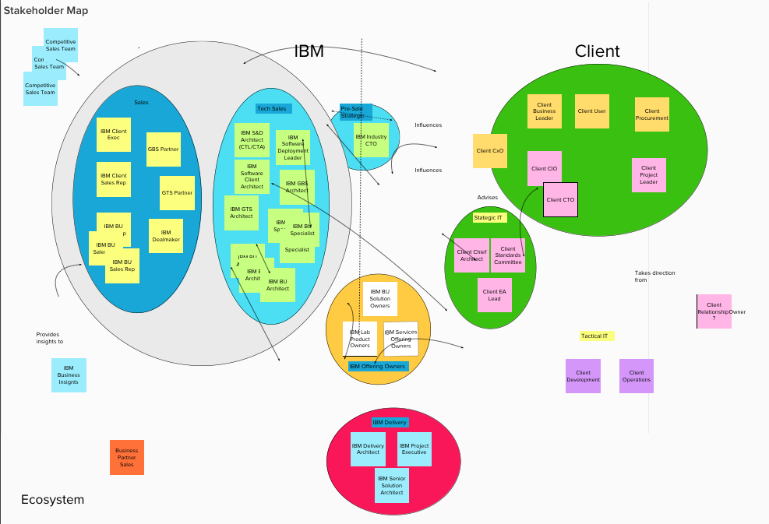
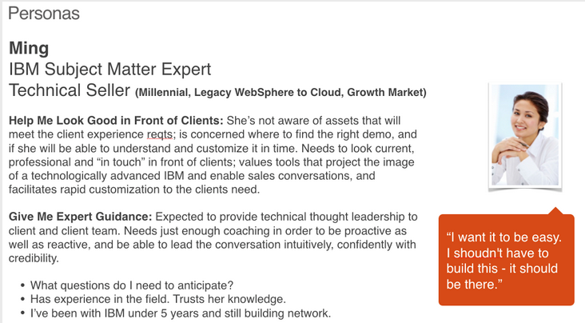
Developing an understanding of the problem space
Develop a stakeholder map.
People and Profiles Resources:
Who is involved?
How are they involved?
How do these roles interact with each other?
Persona creation:
who are the people who interact in the stakeholder map
What are their desires and objectives?
Technical Collaboration Hub: Design Thinking: https://w3-connections.ibm.com/communities/service/html/communitystart?communityUuid=b500e12f-aaca-453f-8305-098f3e1f31b3
Creating a persona is more than just putting a name & a face in a circle. In this example, we’ve created a composite profile & demographics made up of likely users (or user's users) most impacted by the problem or who would benefit from the solution

Slide 5
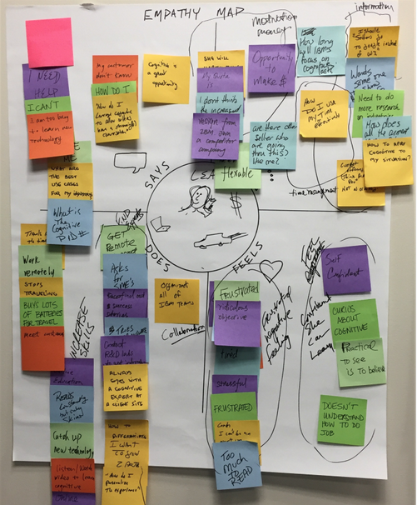
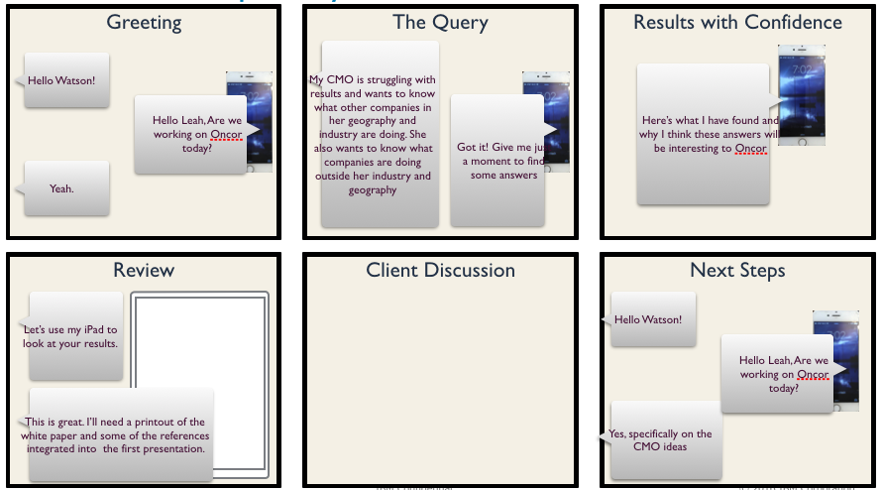
From Understanding to Ideation
Develop an empathy map
Define the As-Is environment
What is the motivation to act and what’s the desired outcome?
What are the steps in between?
What is our person Saying, Doing and Feeling while executing those steps?
Identify Pain Points and Big Ideas
What makes the current approach unpleasant for our person?
What would make the process of achieving their desired outcome delightful?
Create a 6 cell storyboard from the Big Ideas

Slide 6
Hills and Agile: First Steps
KISS
Model the User Experience
Define the ‘happy path’
Resources
“Everything should be made as simple as possible, but no simpler.”
Fast and simple. Use a tool like InVision to validate
Bring in graphic artists to do design work
Validate with Sponsor Users.
Give the (InVision) UX to the developers
What’s the User Story (6-cell from IBM Design Thinking)
Using that story, what’s the primary path from login to success?
Build that first, stub everything else.
Iterate and enhance to address more user pain points.
IBM Agile Academy:
https://agileacademy.mybluemix.net/
Bluemix Garage: https://www.ibm.com/cloud-computing/bluemix/garage

Slide 7
Principles, Code and Reuse
Core Principles
Design
Execution
Resources
High Cohesion and Separation of Concerns
Loose Coupling and RESTful services
Reuse
Fail Fast
Validate the UX quickly with Sponsor Users - use a tool like InVision
Create basic Architecture artifacts - system context, high level architecture design
Document your decisions while your designing and developing
KISS
Start with what’s publicly available in your cloud instance
Keep the design simple
Iterate
Enterprise Github:
https://github.ibm.com
Structure of a good principle:
https://w3-connections.ibm.com/blogs/24HourDesign/entry/enabling_effective_decisions_in_a_distributed_collaborative_environment?lang=en https://www.ibm.com/cloud-computing/bluemix/garage

Slide 8
Congratulations! You’re ready to build demos for your client!
From Design Thinking
What’s the story you’re going to tell?
Create a 6-cell storyboard
Create your systems context diagram
Create your high level architecture
Define your Bluemix Environment
Keep it Simple!!!!, keep it supported
Understand the technology capabilities and limits of your environment
for example, if you can’t get to core client web pages, don’t make that part of your prototype. You can, however, get to public web pages from Bluemix, so that’s easy to have as part of your prototype.
Use the code you’ve already built and put in your own git repository
Search DeveloperWorks and public github for other code samples
Lay out your UX - again, keep it simple
Define what core RESTful services you need to make your UX work
Go forth and Conquer!

